Slide 1

Investment Recommendation System
By
1902070 - Shashank Karna
1902075 - Akash Khatri
1902087 - Rishika Lulla
Project Guide: Dr. Anil Chhangani

Slide 2
Introduction
Money is one of the most important aspects to earn a living. And to live in this world of increasing inflation, one should know how to spend as well as save money wisely. Investment is a smart option to get a second income. But investing can be a daunting prospect for beginners, with an enormous variety of possible assets to add to a portfolio.
The investment recommender system will predict various stock values and curate a SIP plan within the users’ allowable investment amount for a month.
Notes:
Some of the trending investment options are Stock Market, Mutual Funds, Gold, Real Estate, etc. For a common man, investment options like Stock Market, Mutual Funds, etc. seem a very complicated and confusing task. A common man is very cautious of the money that he/she is investing on anything. ((But investment is a very smart and efficient way to earn money.)) For many amongst us, finance is akin to Latin, incomprehensible, and complicated.

Slide 3
Our Objective
Of India's 1.36 billion people, only about 3.7 per cent invest in stock market.
Investment is a complex process, especially understanding stock market, mutual funds, etc.
Analyze risk factors and help people invest their hard earned money better.

Slide 4
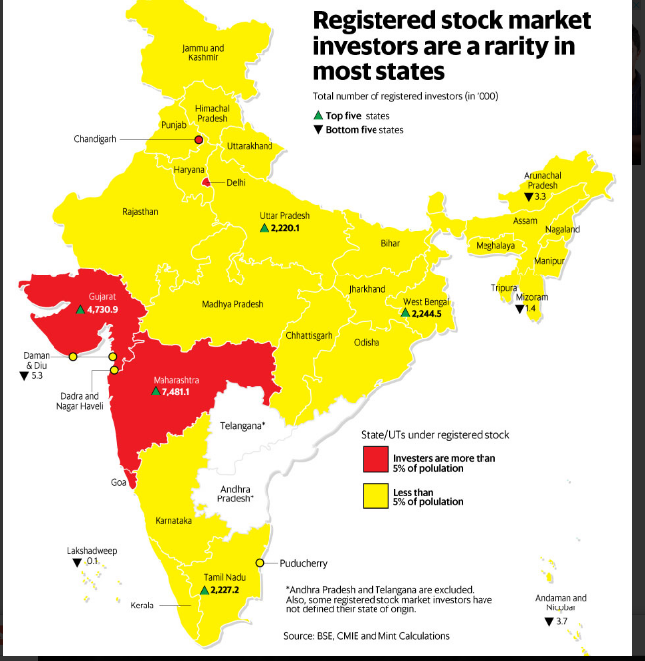
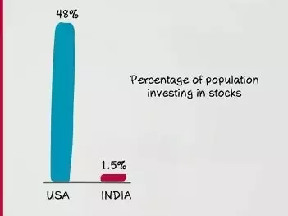

Slide 5


Literature review
app is an investment platform for beginners. It allows investors to trade and invest in Stocks and Mutual funds. It also lets the user to track all the investments, annual returns etc.
is a digital wealth management service found in 2018, which provides passive investment strategy. It creates customized fund recommendations suited to users’ goals and risk profile.
Notes:
Even though investment still isn’t a very popular concept, there are a few really useful platforms that enable users to invest smartly.
1.Groww 2. Finity
There is a common issue with these platforms though. They still rely on manual work to some extent.
Analyzing Stock price (Open, Close, High, Low), Complete History (For analysis)
Market Depth (History of quantity of orders sold and bought.)
Tracking news, press releases, IPO releases, Financial result updates etc.
Multiple variables like EMA, RSI, SMA, Macd, CCI, etc. for research.

Slide 6
Problem Statement
Recommend SIP plan within user’s specified investment amount by predicting stock values based on previous data using LSTM.
Notes:
SIP(Systematic investment plan) is a method of investing a fixed sum, regularly, in a mutual fund scheme. SIP allows one to buy units on a given date each month, so that one can implement a saving plan for themselves.

Slide 7
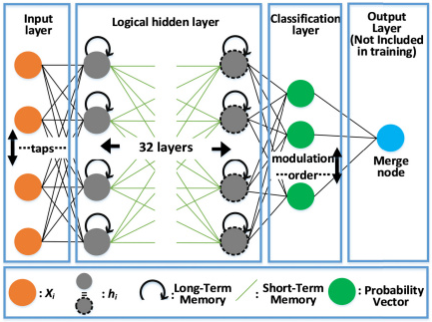
Algorithm - LSTM
Long Short Term Memory is a kind of recurrent neural network (RNN).
LSTM can by default retain the information for a long period of time.
It is used for processing, predicting, and classifying on the basis of time-series data.
Notes:
It tackles the problem of long-term dependencies of RNN in which the RNN cannot predict the word stored in the long-term memory but can give more accurate predictions from the recent information.

Slide 8

Training Dataset
Includes:
Stock name
Close Price
Date

Slide 9
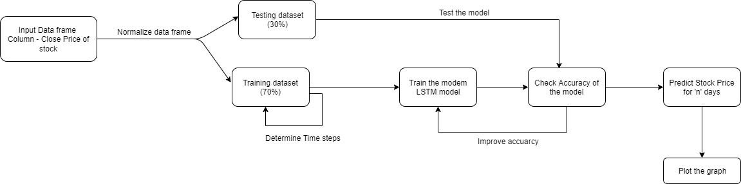
Block Diagram

Slide 10




Technologies Used
Python
TensorFlow
Keras
Matplotlib
Jupyter Notebook
Keras

Slide 11

Thank You!

